Slide 1
Summary
This dataset is medical bills of patients
I used it to analyze which variables has bigger effects on medical bills
The result shows smoking has a strong correlation with charges
Other notable variables are Age and BMI.
Employers can use this finding to do something to stop their employees from smoking.
Employers pay higher premium for their smoker employees as compare to non-smokers

Slide 2
 | region | sex | children | bmi | smoker | age | charges
region | 1
sex | -0.00459 | 1
children | -0.01657 | 0.017163 | 1
bmi | -0.15757 | 0.046371 | 0.012759 | 1
smoker | 0.002181 | 0.076185 | 0.007673 | 0.00375 | 1
age | -0.00213 | -0.02086 | 0.042469 | 0.109272 | -0.02502 | 1
charges | 0.006208 | 0.057292 | 0.067998 | 0.198341 | 0.787251 | 0.299008 | 1
A strong positive correlation is observed between
smoker and charges. Then age and bmi also have a positive correlation with charges. Since smoking is a stronger correlation, we investigate smoking in more detail

Slide 3
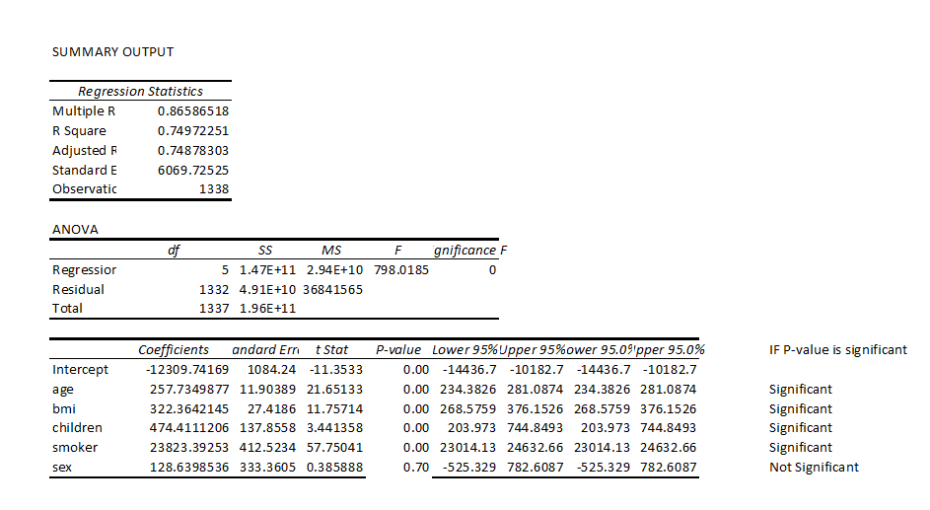
Regression Analysis
Multiple R is 0.86 that means correlation between the independent variables and dependent variable is 86.6%
The result of Adjusted R-square shows that 74.8% of dependent variables are explained by independent variables
The regression result shows that variable "Sex" is not significant because it's p-values is greater than 0.05. And P-values of all the other variables are less than 0.05 so we will not include “sex” in analysis

Slide 4
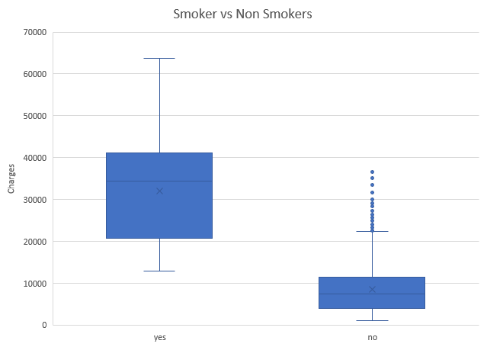
Smoking has a strong correlation with the charges . The box plot shows that smokers have more charges as compare to non-smokers

Slide 5
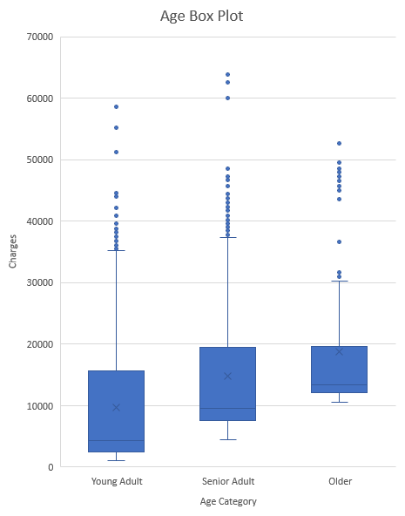
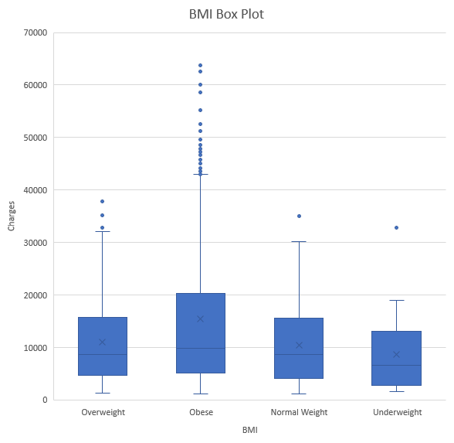

Slide 6

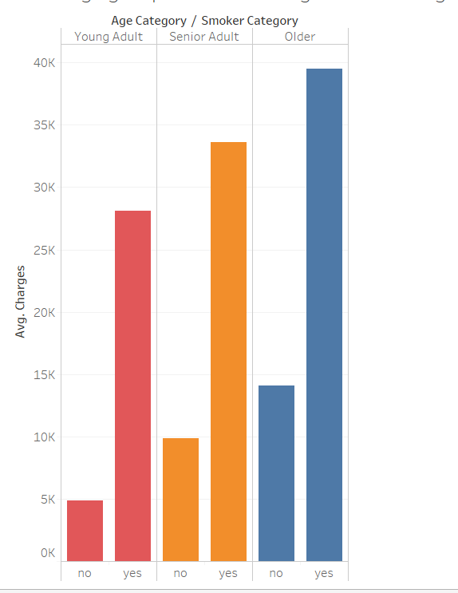
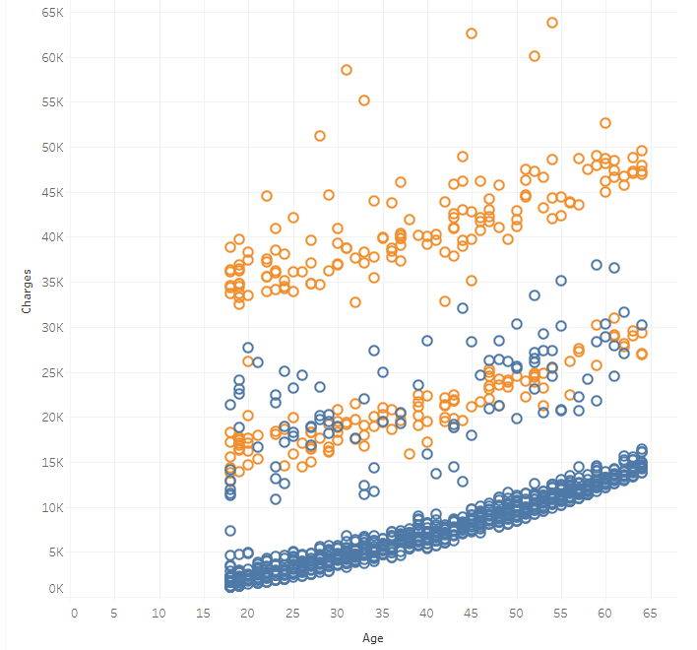
Charges and age have positive relation. Even non-smoker patients charges increases with the increasing age but smoker patients charges increases more as compare to non-smokers

Slide 7
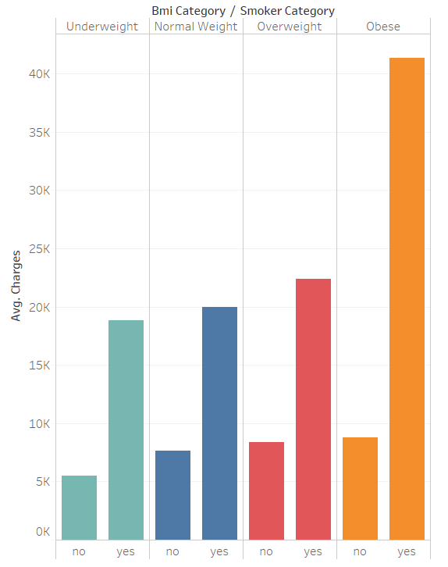
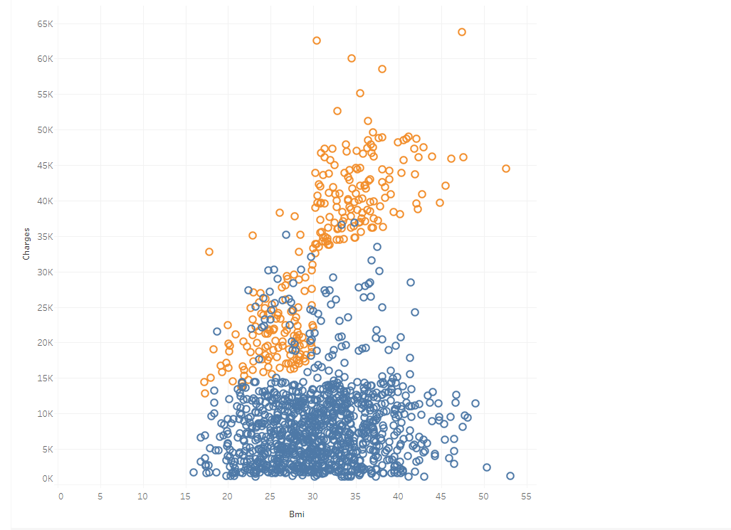
Charges and BMI have positive relation. Even non-smoker patients charges increases with the increasing Bmi but smoker patients charges increases more as compare to non-smokers

